Slide 1
ParkingSpotter
Kevin Forte - 1940058
Lorenzo Thomas Contessa - 1949580

Slide 2
The problem vs The solution
Problem: Finding parking in urban areas is often a challenge: people waste time and fuel driving around looking for an available spot. There is no centralized system to know in advance where to park or to book a space. At the same time, private parking owners lack simple tools to make their spots available and manage reservations.
Solution: ParkingSpotter is the app that simplifies mobility: it allows users to find available parking nearby, book or cancel a spot in seconds. Owners can add their parking spaces, make them visible to everyone, and easily manage availability and information. This makes parking faster, more organized, and stress-free, especially thanks to its responsive and mobile-friendly design

Slide 3
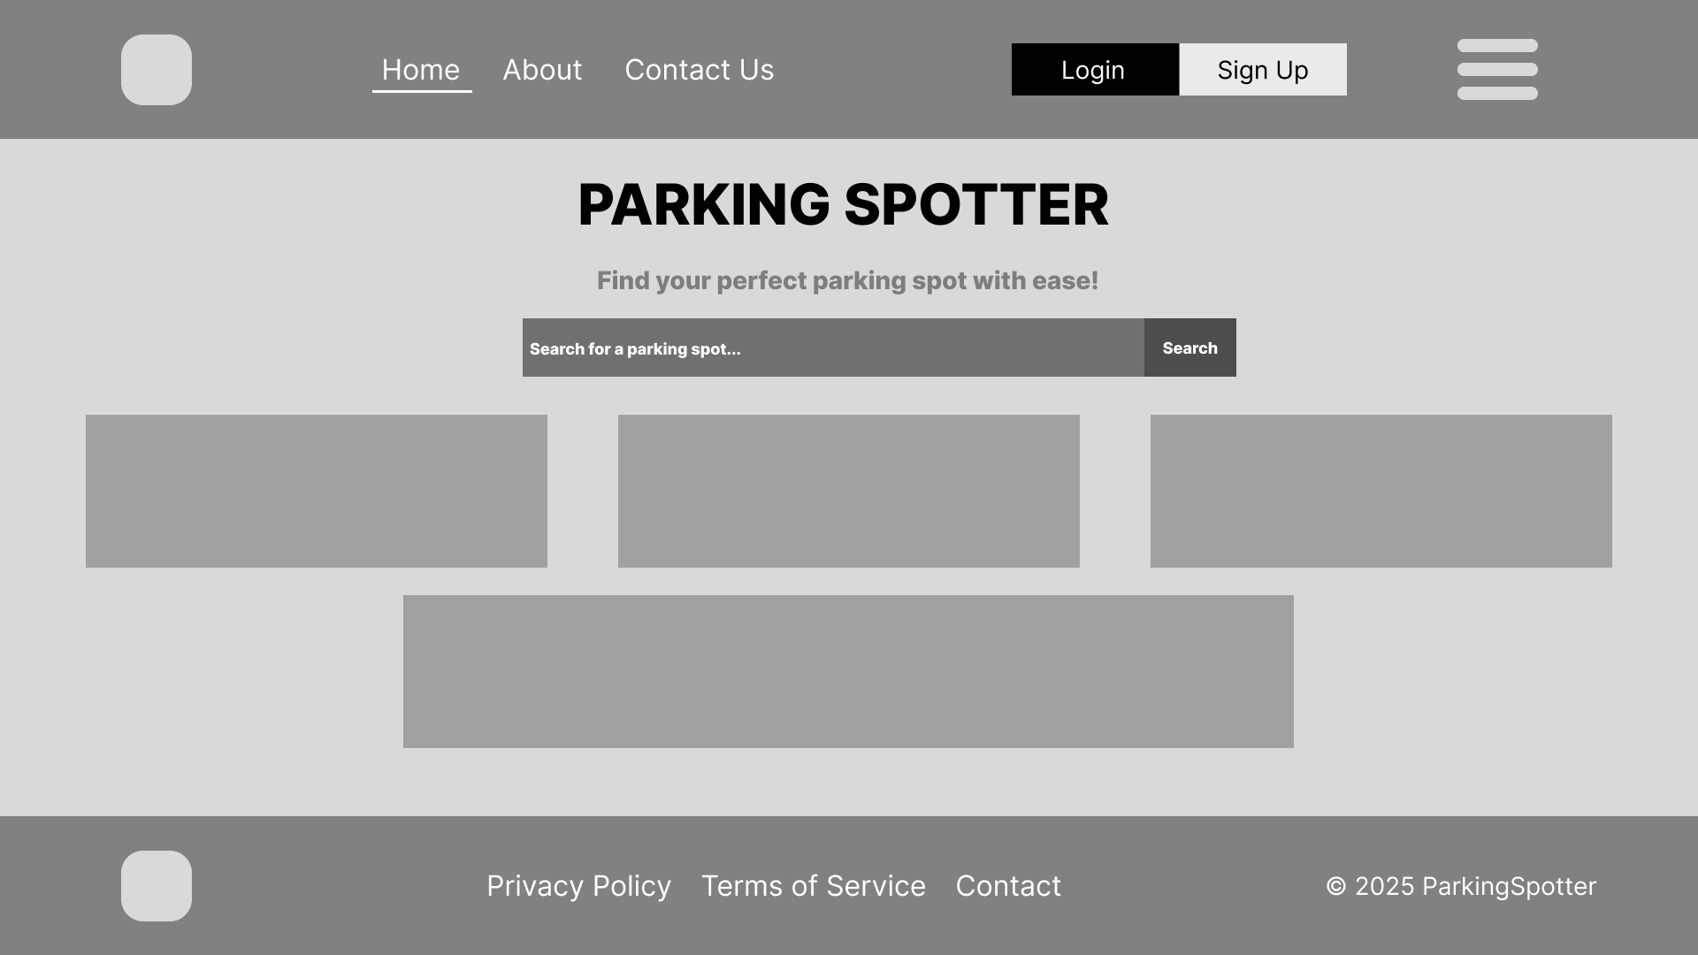
Mock-Up - Home
Through the home page, users will be able to get information about the application, its purpose and the other links of the application through a user friendly interface. In addition, user who are already logged in will be able to search for their nearest parking lot without navigating inside the application

Slide 4
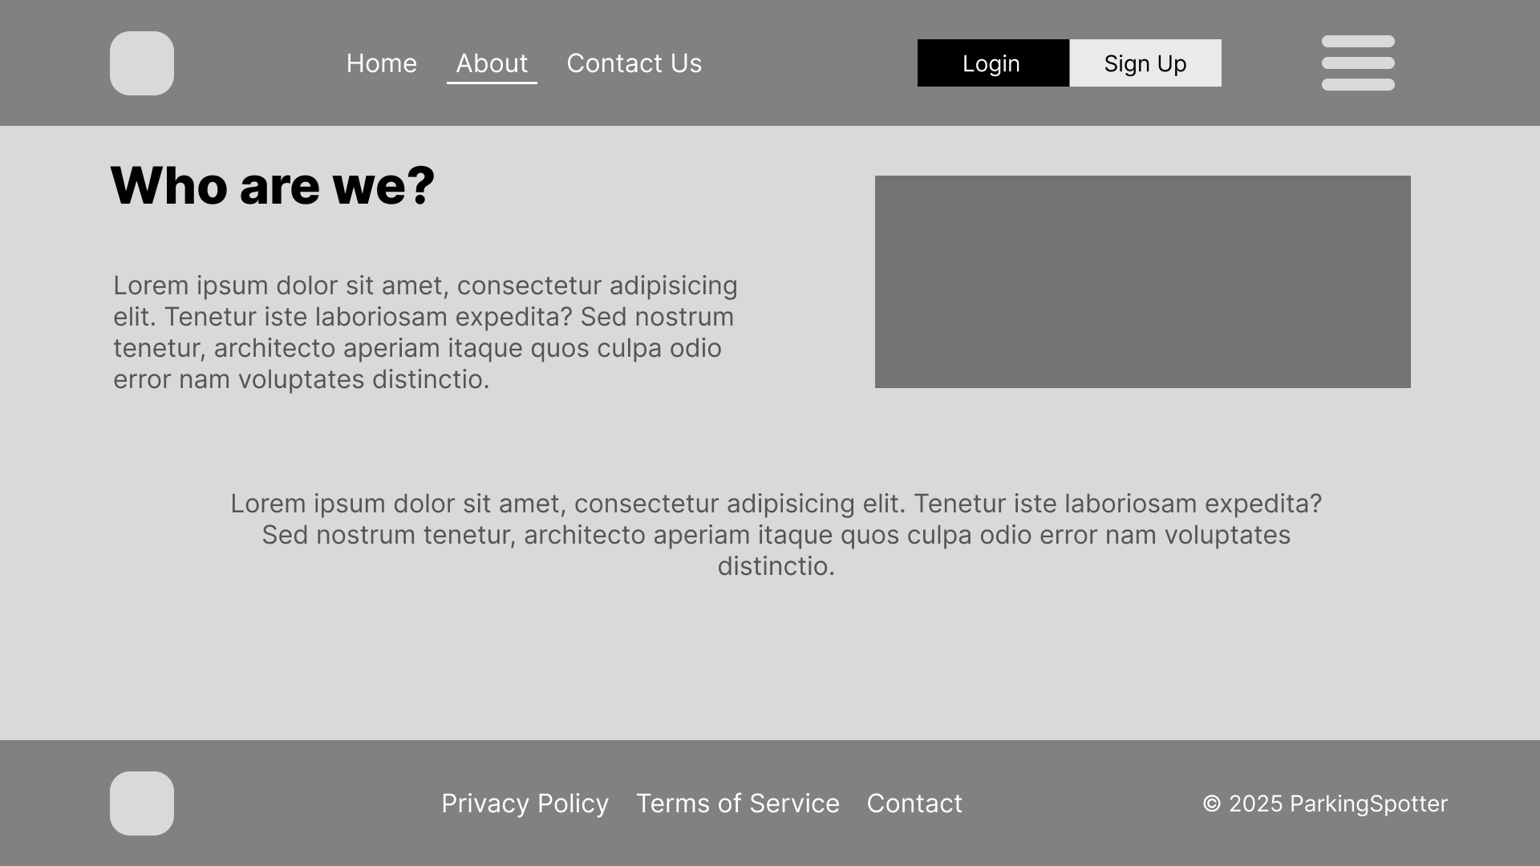
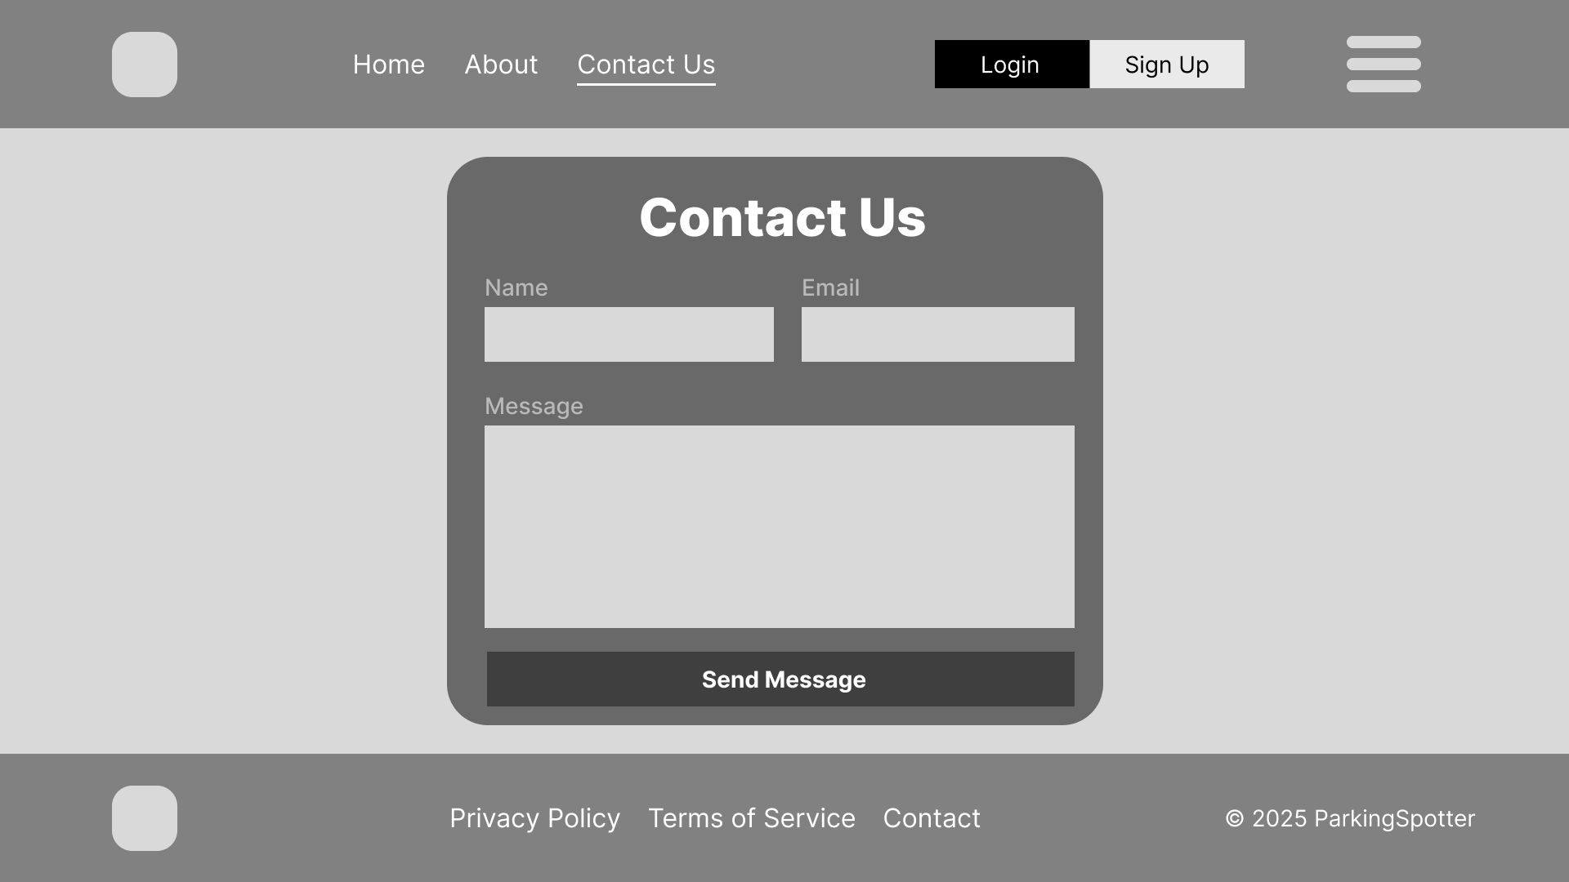
Mock-Up - About & Contact Us
User will have easy access to various information about our company inside the about page, while, in case of any kind of problems, they can contact our support team through filling the form easily found in the contact section

Slide 5
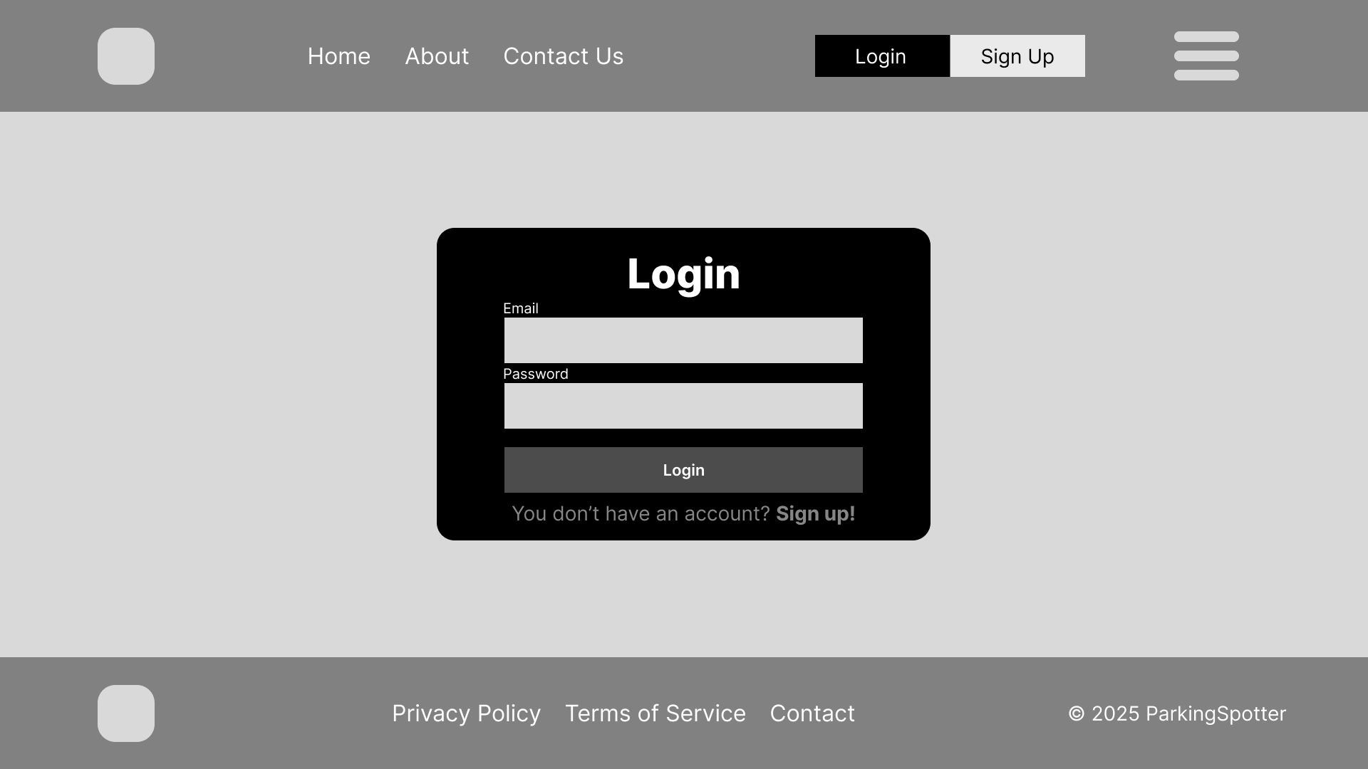
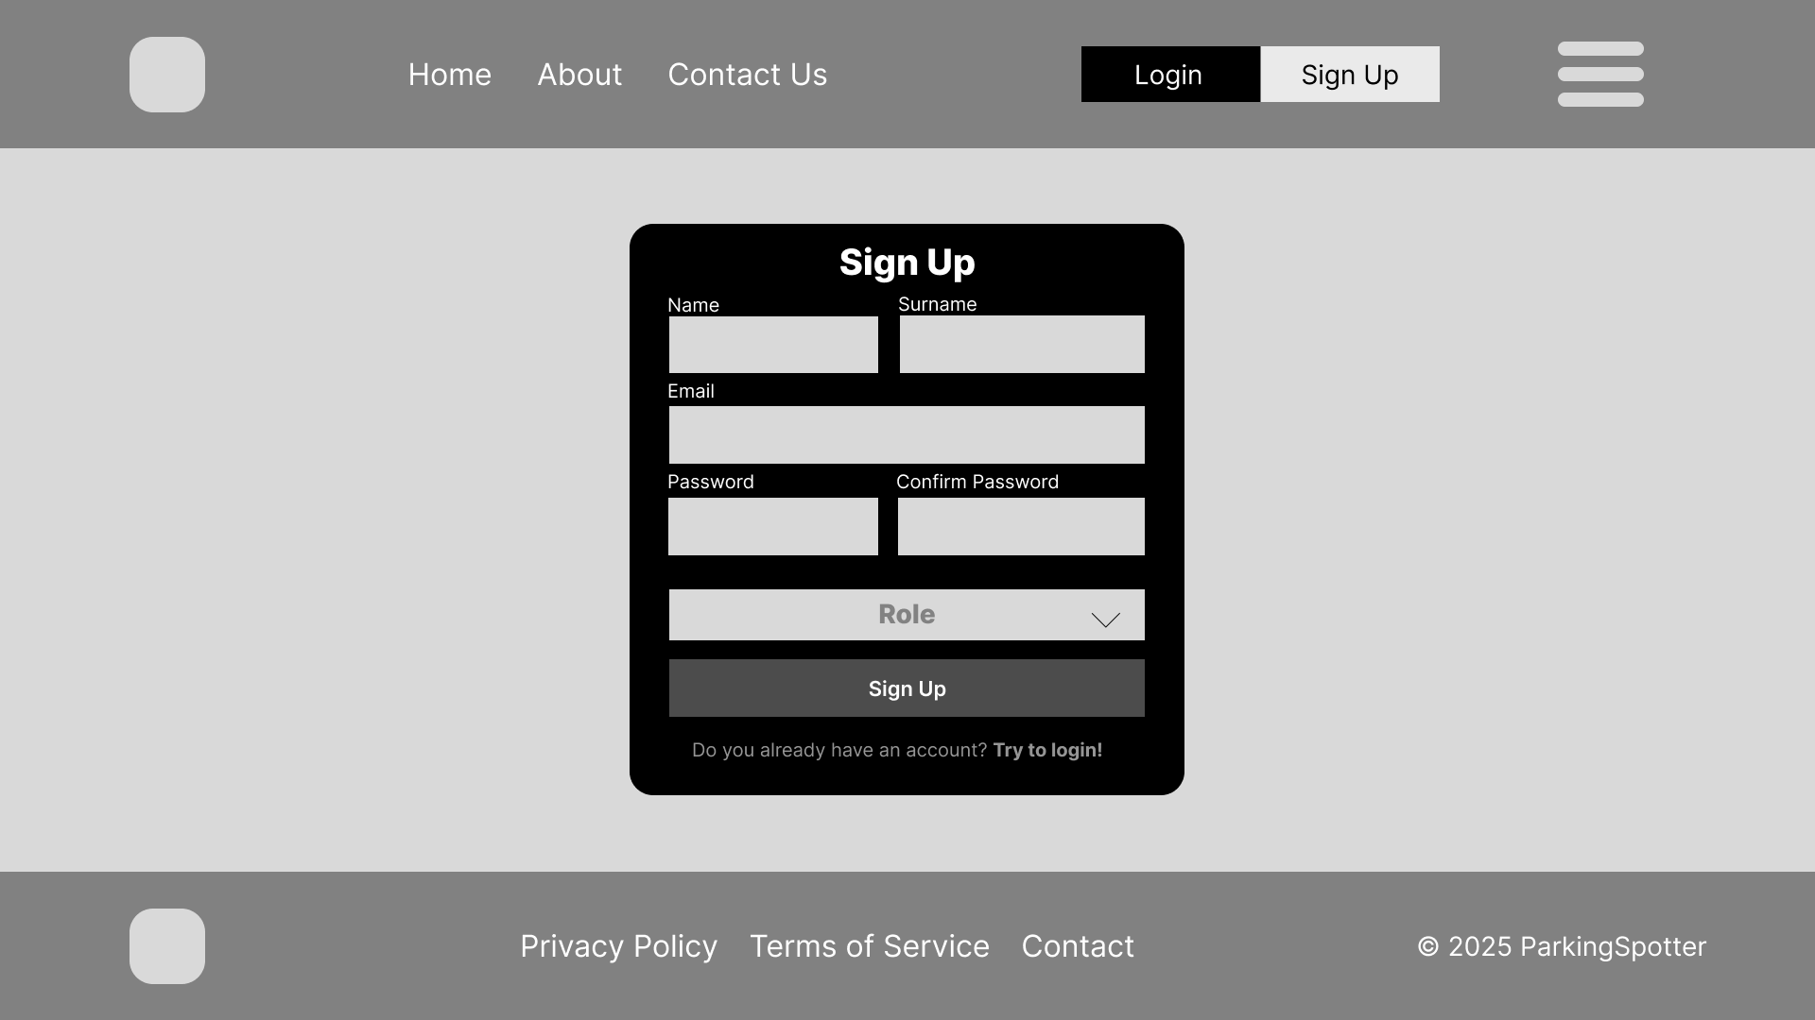
Mock-Up Login/Signup
Users will be granted easy and secure access to the platform through an easy login/signup form, allowing us to gather data such as your name, surname, email address and the type of role you are applying (Driver, Parking Owner) in order to offer the best possible experience suitable for you

Slide 6
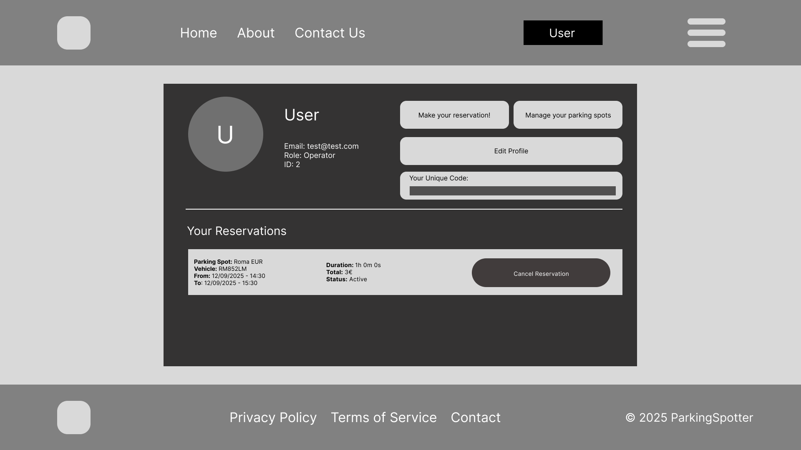
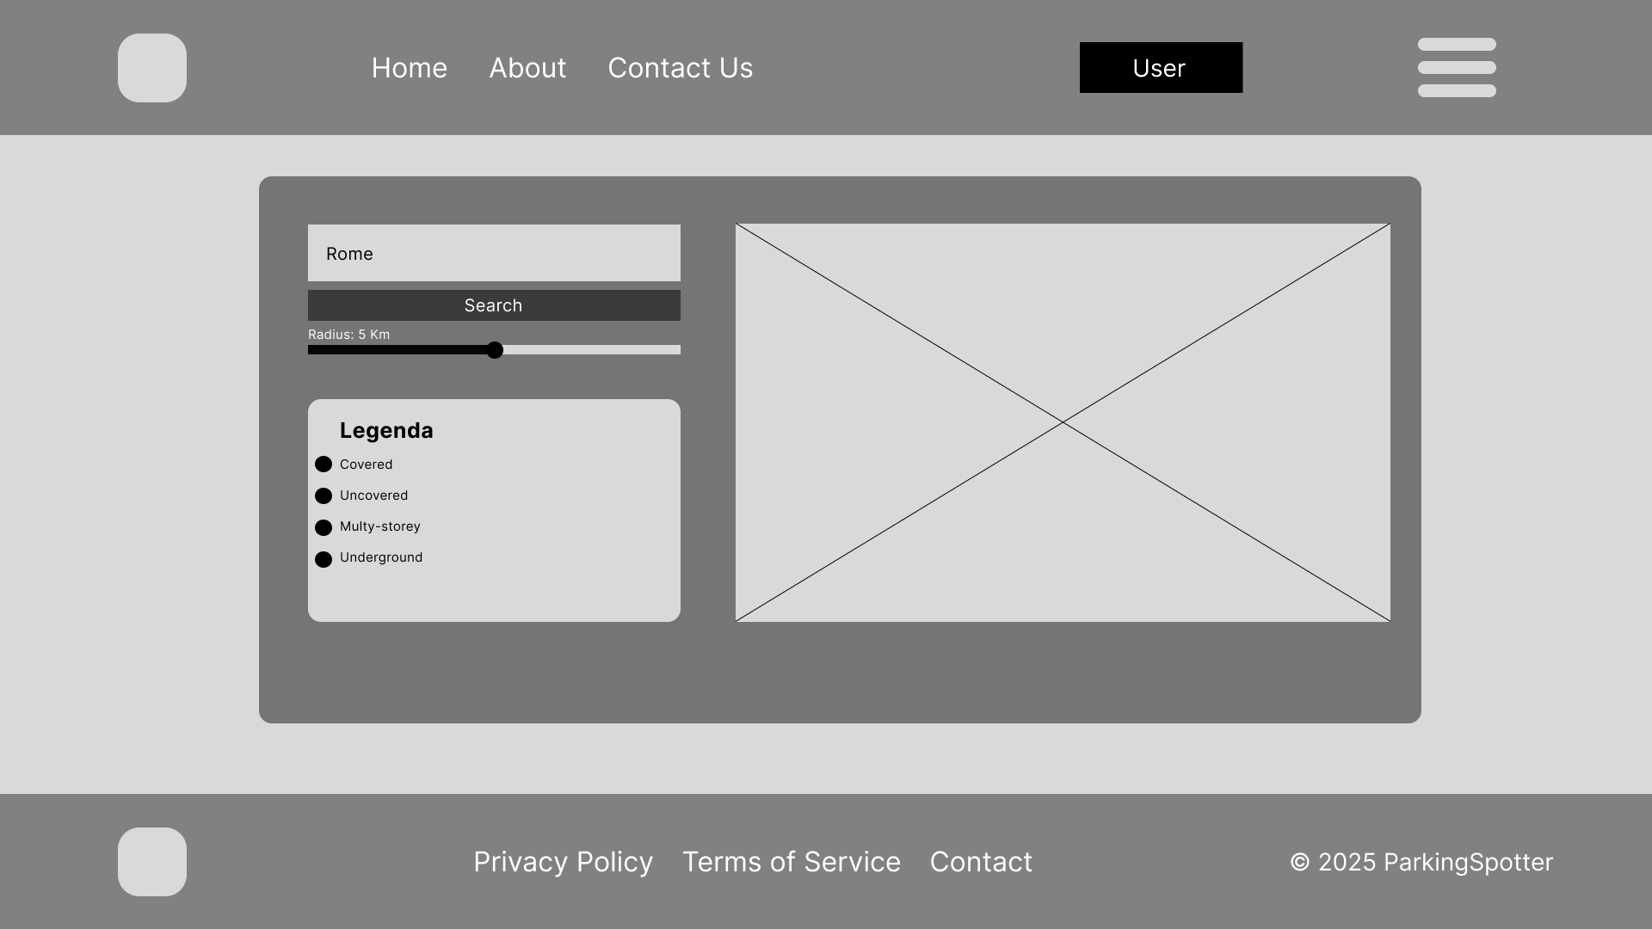
Mock-Up - Profile & Make a Reservation
In ParkingSpotter, users will be able to get access to their own profile page, containing informations like their name, surname, email address, reservation history with the possibility to edit these informations whenever they want. Once in the profile page, users will be able to access the reservation section in which they can type their own destination, the preferred radius of the search and try to book in one of the various results our database is going to provide

Slide 7
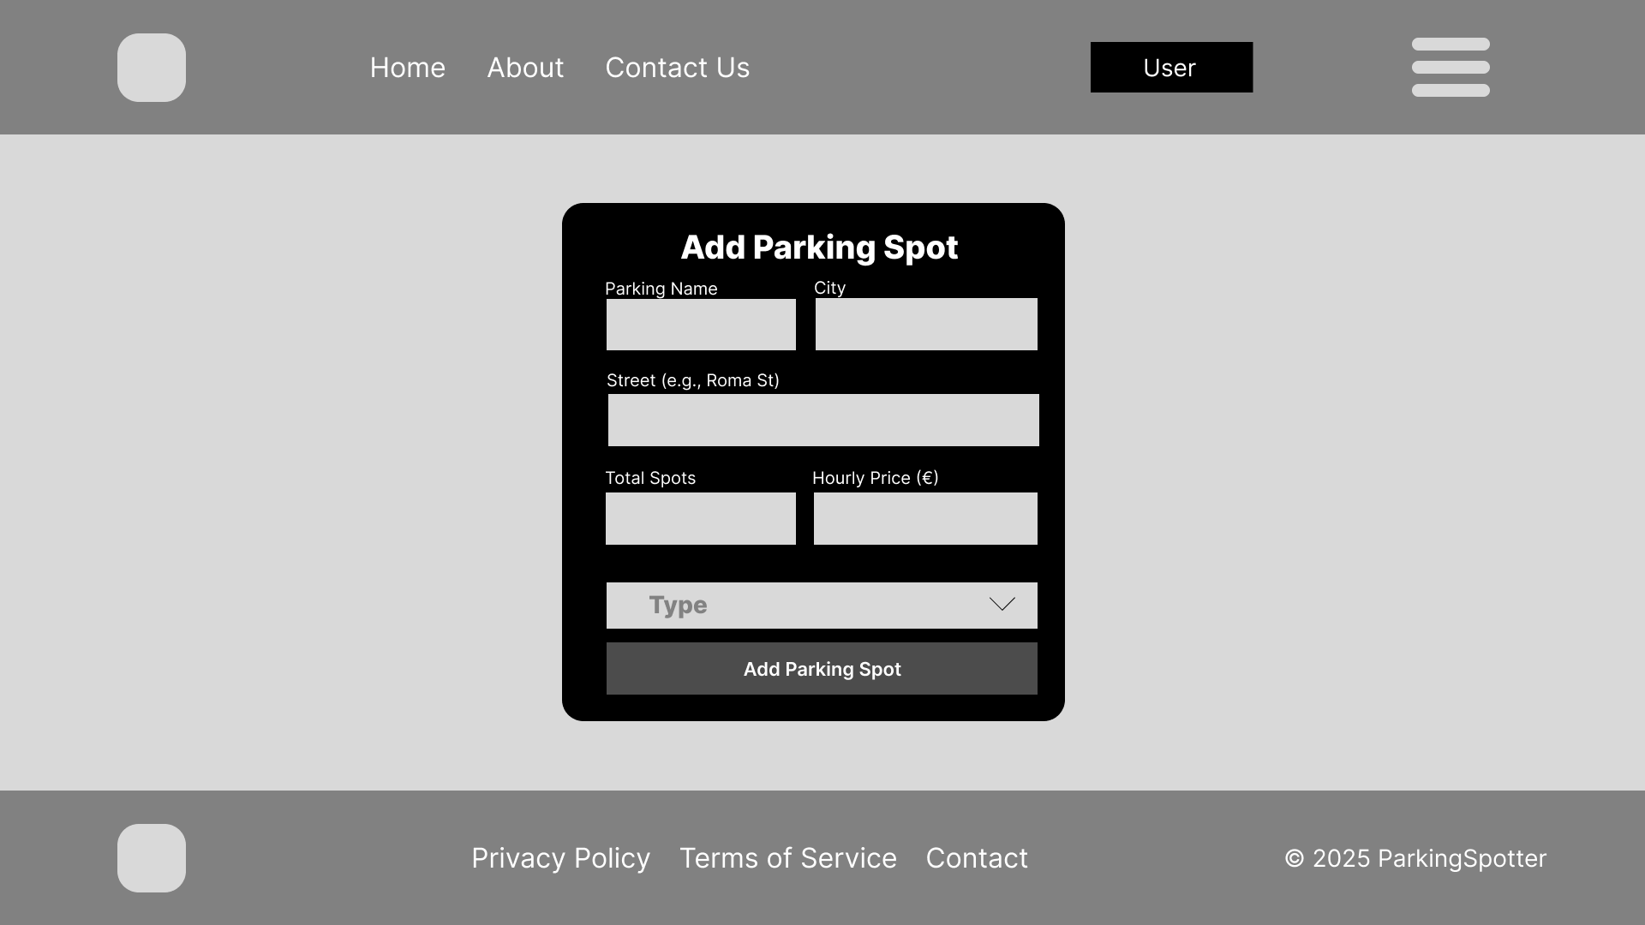
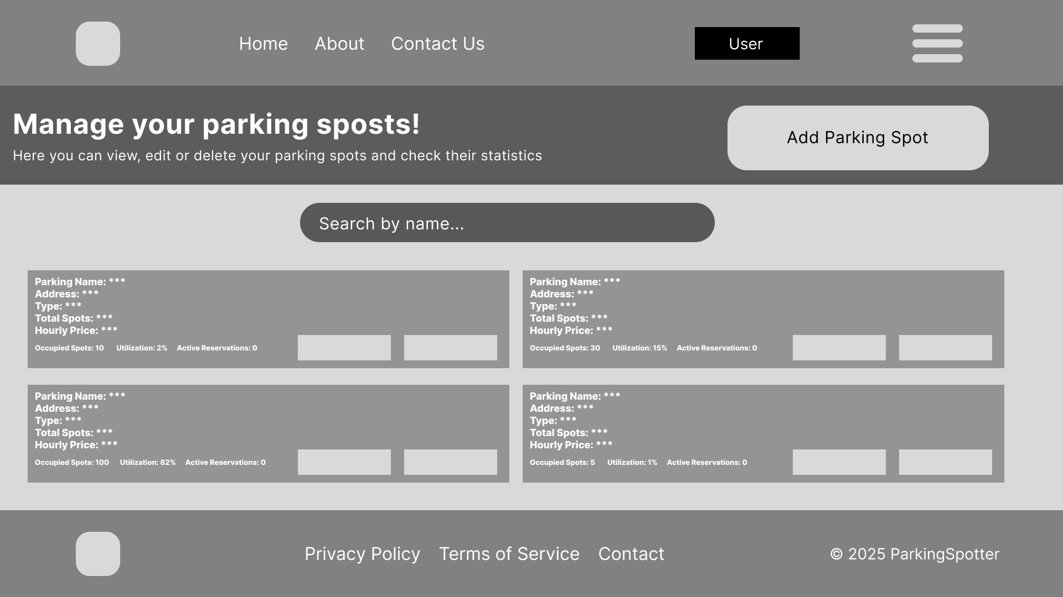
Mock-Up - Add/Manage Spots
This functionality is reserved for parking owners. It allows them to introduce their own parking lots to the system, letting people know of its existence and allowing them to make reservations. In addition, parking owners will be able to access to a separated section in which they can manage each one of their parking spaces.

Slide 8
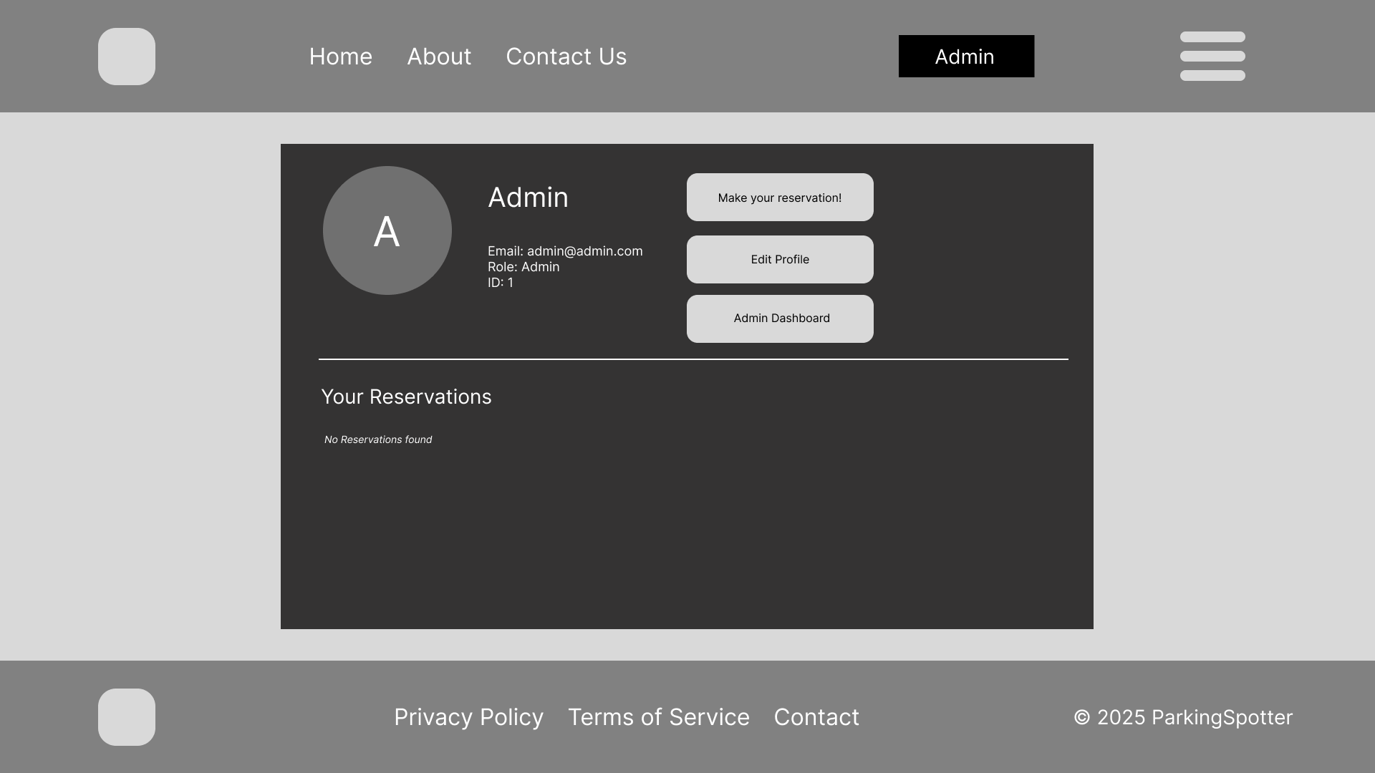
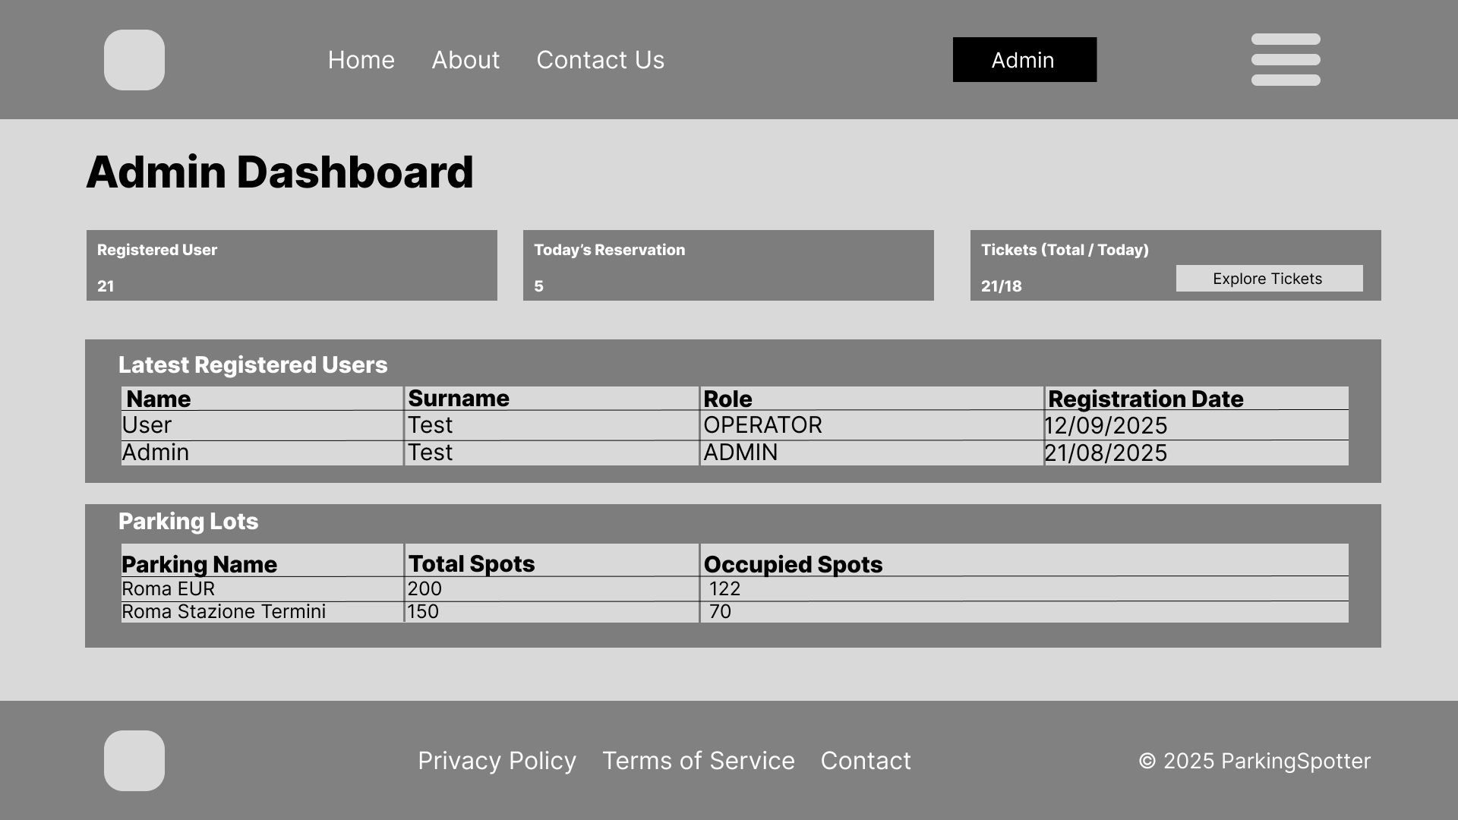
Mock-Up Admin Dashboard
Once logged in the system, admin will be able to access to their own profile page, which will be missing of the unique code, feature reserved for the parking owner. Instead, will be granted access to a special dashboard in which they can manage the entire system through comfortable metrics and data such as recently registered users, latest parking lots added to the system and parking lots filtered for each users

Slide 9
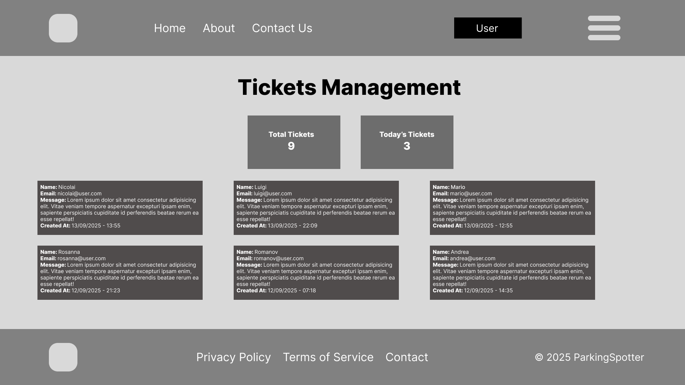
Mock-Up - Tickets
In the end, admin will be able to consult the ticket section, containing each tickets sent by users, in order to locate the reported issues and fix them in a timely efficient manner.

Slide 10
Technology Stack
Layer | Technology
Backend | Node.js, Express, RabbitMQ
Frontend | React, React Router, GSAP, OpenStreetMap API
Database | PostgreSQL
Deployment | Docker

Slide 11
API Endpoints

Slide 12
Http Method | URL | Description
POST | /auth/register | Registers a new user.
POST | /auth/login | Authenticates a user.
POST | /auth/user | Allows a user to update their own profile information.
GET | /auth/stats | Returns the total count of users in the system.
GET | /auth/list | Returns a list of the latest registered users.
GET | /me/uniqueCode | Returns the unique code for the currently authenticated user.
Http Method | URL | Description
POST | /tickets | Submits a new support ticket from a user.
GET | /tickets | Retrieves the latest support tickets.
GET | /tickets/stats | Gets ticket statistics including total and daily counts.

Slide 13
Http Method | URL | Description
POST | /reservations | Creates a new reservation.
POST | /reservations/:id/cancel | Cancels a specific reservation.
GET | /reservations | Retrieves all reservations for user.
GET | /reservations/active/:parkingId | Gets all active reservations for a specific parking lot.
POST | /parkings | Creates a new parking lot.
GET | /parkings/list | Lists all parking lots owned.
GET | /reservations/stats/today | Count of today reservations.
Http Method | URL | Description
GET | /parkings/list/admin | Lists the latest parking lots.
GET | /parkings/list/admin/search | Searches for parking lots by operator email.
POST | /parkings/:id | Edits a parking lot.
DELETE | /parkings/:id | Soft-deletes a parking.
GET | /parkings/:id/stats | Gets detailed statistics for a parking.
GET | /parkings/nearby | Finds parking lots within a specified radius.

Slide 14
Frontend Pages

Slide 15
Page Name | Path | Description | Page Name | Path | Description
Home | / | Landing page of the application | Reservations | /reservations | Make a new reservation
About | /about | Information about ParkingSpotter and its purpose | Add Spot | /add-spot | Add a new parking spot to the platform
Contact Us | /contact | Form and details to get in touch with the team | Manage Spots | /manage-spots | Edit, update, or remove owned parking spots
Login | /login | Access the application with user credentials | Admin Dashboard | /admin | Administration panel to manage users and system data
Sign Up | /signup | Create a new account to use ParkingSpotter | Tickets | /tickets | View support requests and submitted issues
Profile | /profile | View and edit personal information and settings. Access to reservation history

Slide 16
Github Repository
Access our source code and documents here:
https://github.com/Sk4rKr0w/1940058_ParkingSpotter

Slide 17
Docker usage
Run the project using Docker:
In order to boot the project do the following actions:
Install Docker
Clone git repository
Inside the repo folder launch the command “docker compose up -d”
To stop the Project: docker compose down
To view containers Logs: docker logs -f <container_name>
Inside the docker-compose a pgadmin image is included, so you can access DB easily by going to http://localhost:8080.

